Slide 1

AR Blackjack Assistant
Remote Rendering Application
Team: ARAnnihilators
Membership: UCCS
Faculty Sponsor: Bill Michael
Faculty Sponsor: Dr. Dana Wortman
10/7/2022

Slide 2
OUTLINE
Detailed Description of Design
User Manuals and Instructions
Detailed Drawings of Parts and Assembly
UML Diagrams
Software Description
Bill of Materials

Slide 3
Detailed Description of Design
User Interface design using TextMeshPro, Canvas, and Panel game objects.
Start button, using MRTK(Mixed Reality Toolkit) to implement hand gesture or controller.
“Vuforia” to be used to have access to AR camera game object.
TCP connection for python and C#.
Probability algorithm written in Python.
Barracuda and YOLO to perform object detection.

Slide 4
User Manual and Instructions
The user manual instructions will inform the user on the proper way of using the hardware and software
The use of infographics and written instructions will be used to detail this information
There is a reference to an online community regarding instructions for troubleshooting that are not included in the report because this platform is up to date and continuously coming up with solutions to new identified bugs in the Hololens Software.

Slide 5
User Manual & Instructions
Turn On
Brightness and Volume Adjustment
Unity Game Engine Project Selection
Unity Game Engine Build Settings
Universal Windows Platform Configuration Settings Using Unity Engine
Using the Hololens Emulator App Launch
Using App
System Shutdown

Slide 6
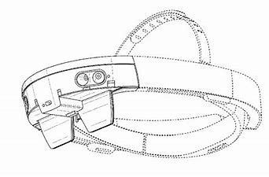
Detailed Drawings of Parts
Notes:
msnpoweruser.com

Slide 7
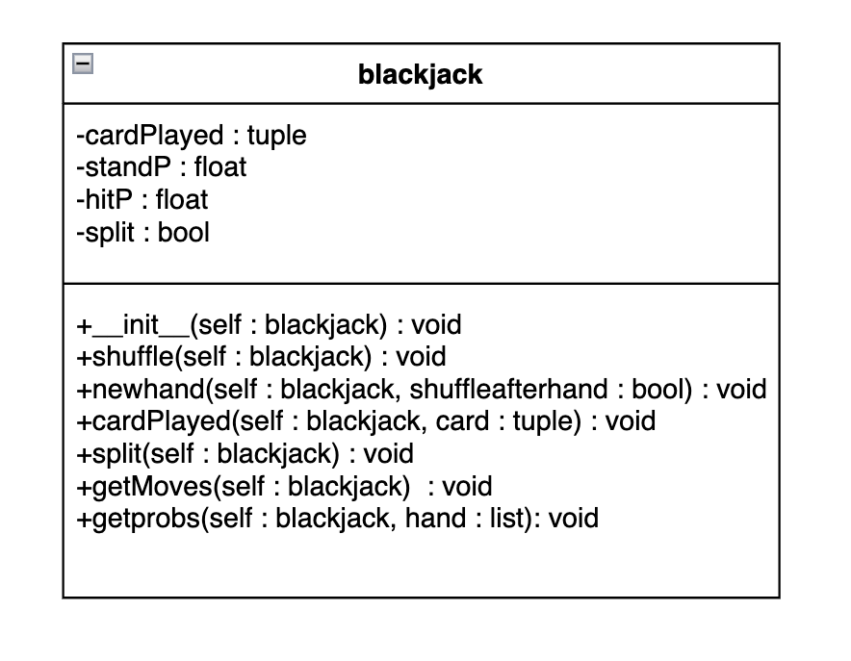
UML Diagrams
Central Python Server Classes
FinalServer, FinalClient, UnityClient
Object Detection Classes
System.IDisposable -> ObjectDetector
ScriptableObject -> ResourceSet
BoundingBox
blackjack - Determines probability, Performs blackjack operations
Game - Performs game logic, Interacts with all other classes
Notes:
In order to show how our remote rendering application will be laid out, our critical design report will include UML Diagrams of all the classes. There will be 3 classes dedicated to creating and handling the central python server, allowing the host computer and HoloLens to exchange information and communicate. There will also be 3 classes focused on conducting the object detection, two of which will be child classes of some classes that are included in imported libraries. The blackjack class will be used to determine the probabilities as well as conducting several blackjack card operations. And lastly the Game class will be utilized to perform all the games logic and will interact with all the other classes.
To the right we have the UML class diagram for the class blackjack. Each variable and method is shown with their corresponding data types and whether it is private or public.

Slide 8

Software Description
Unity Editor to build game, graphics, logic, and Hololens interfacing. Using C# scripts, and onclick events.
TCP connection, using sockets to create a server using ip address, and port number. “UnityClient.cs” script used to communicate. Run server creation on Linux to solve file handle issues.

Slide 9
Software Description
“Blackjack.py” is the probability algorithm used to determine the probabilities of whether its best to hit or stay.
Works by probability propagation

Slide 10
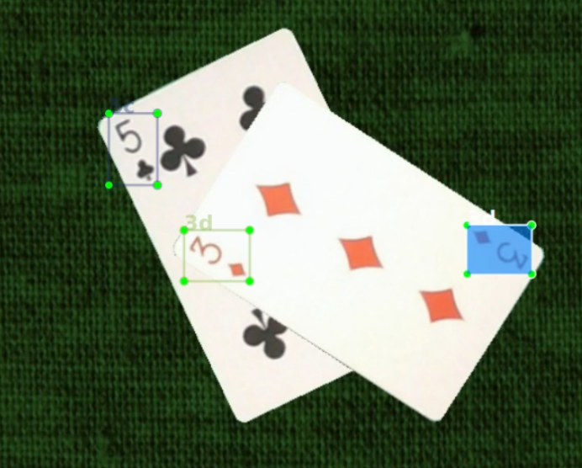
Software: Playing Cards Training
Playing cards trained using python script and special video taking

Slide 11
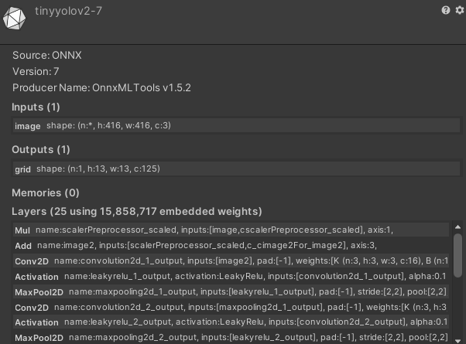
Software: Unity Object Detection Format
Helper Library: Barracuda
ONNX Format for Model
Open Neural Network Exchange
Conversion to this format

Slide 12
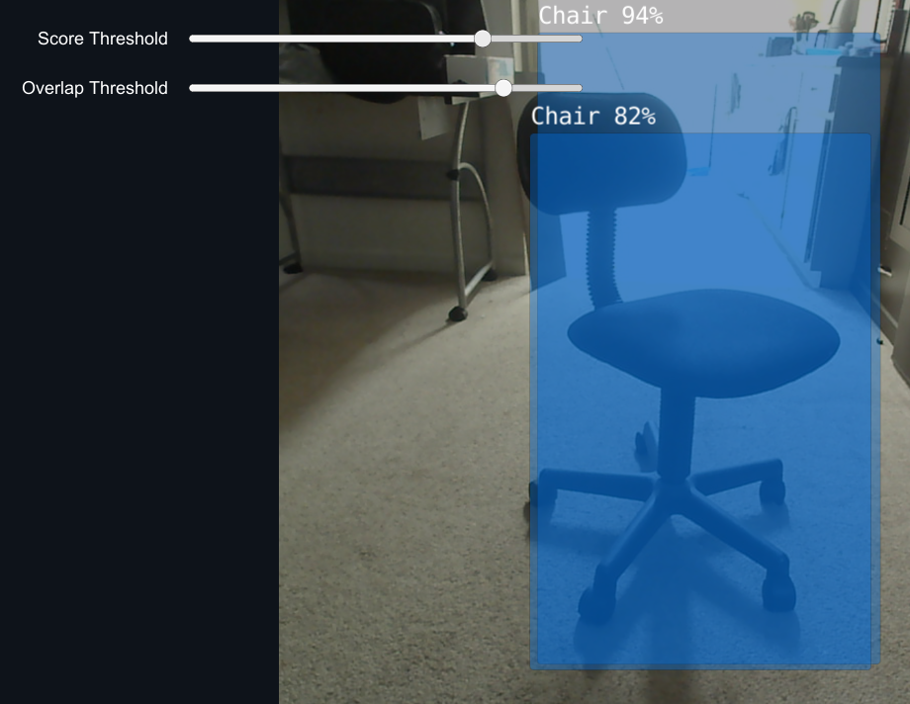
Software: Unity Implementation

Slide 13
Bill of Materials
1 Microsoft HoloLens ($810)
1 AX1800 Dual Band Wireless Router ($40)
1 Deck of Cards Bicycle brand ($3.50)
Current total: $853.50

Slide 14
Any questions?

